Slide 1
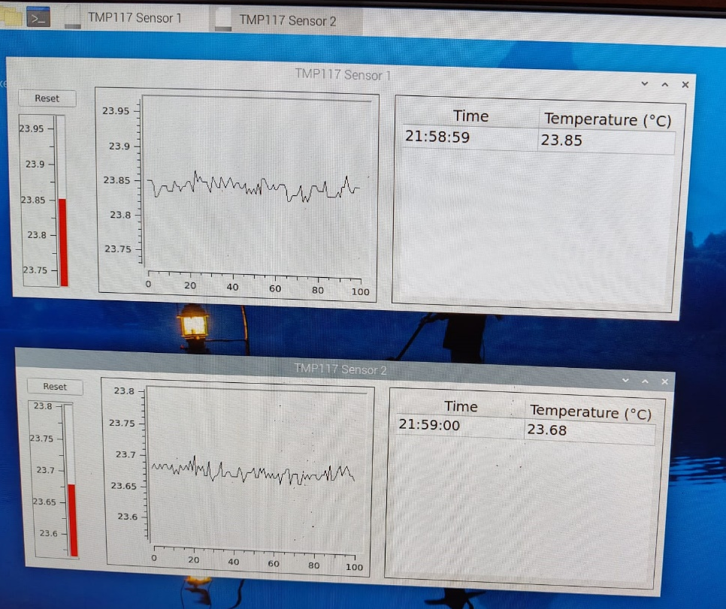
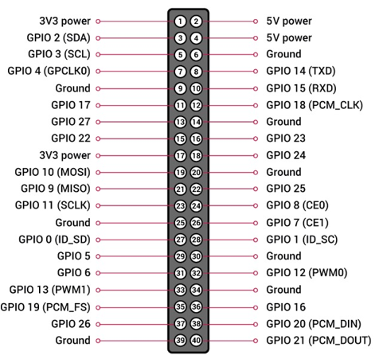
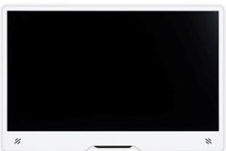
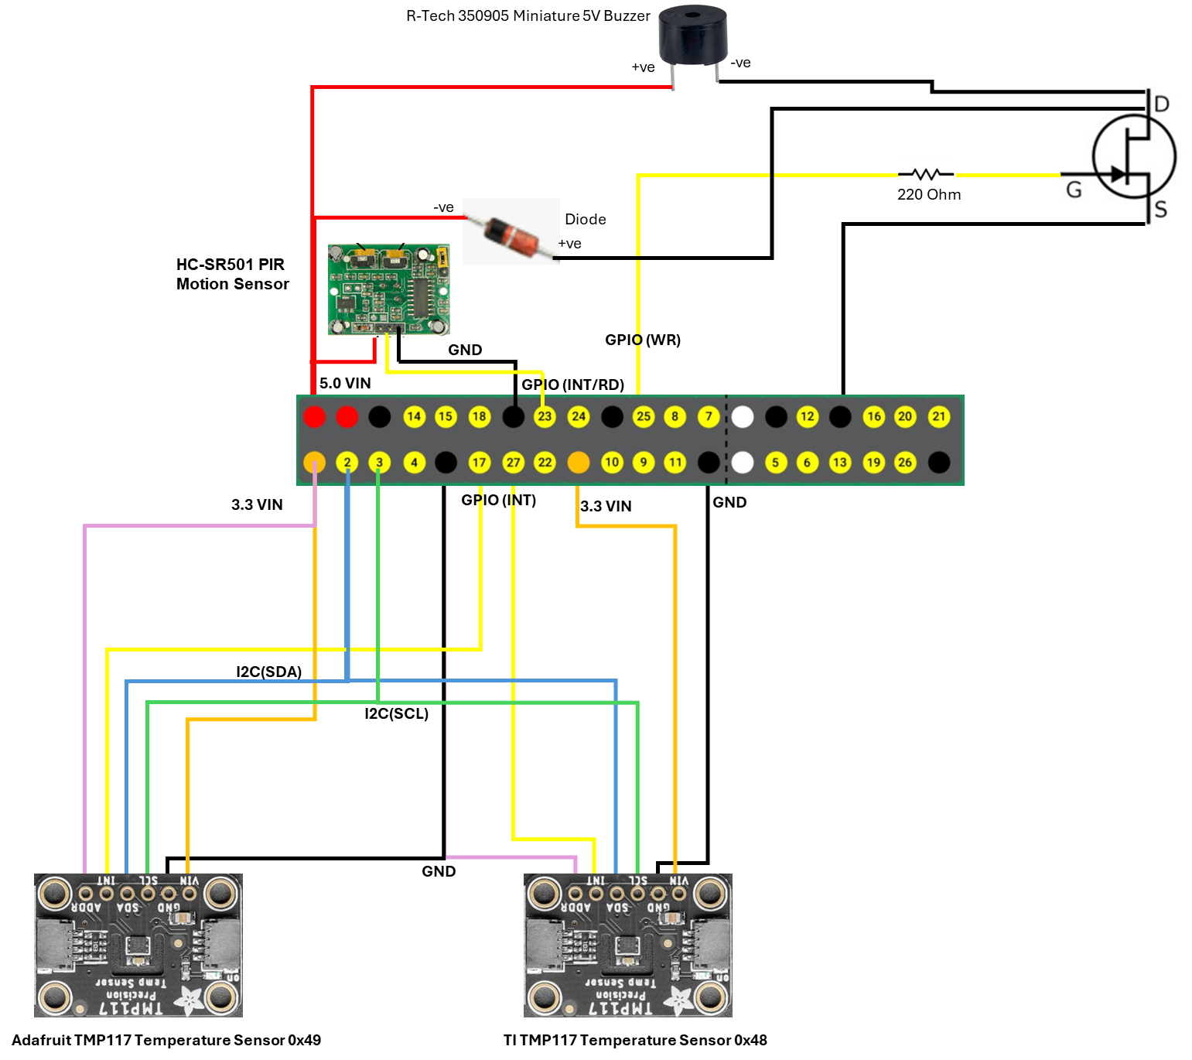
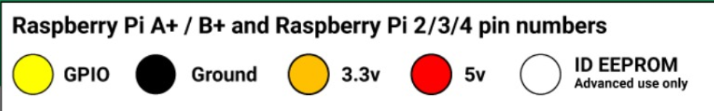
GPIO Pin Layout
SMART MONITORING AND SAFETY SYSTEM
Mains Power Supply
Raspberry Pi 5
HDMI
Raspberry Pi OS
Smart Monitoring and Safety System routine (Event Driven C++ design)
LAN
Wi-Fi
Client 1
GPIO
RJ445
Client N

Slide 2
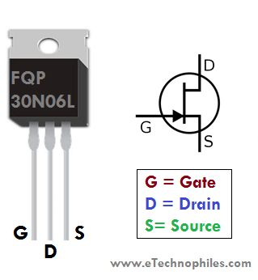
Device | Pin on Device | Raspberry Pi 5 Pin | Notes
TMP117 #1 | VIN | 3.3 V (Pin 1)
 | GND | GND (Pin 9)
 | SCL | GPIO 3 (Pin 5)
 | SDA | GPIO 2 (Pin 3)
 | ADDR | 3.3 V (Pin 1) | I2C Address 0x49
 | INT | GPIO 17 (Pin 11) | DATA READY
TMP117 #2 | VIN | 3.3 V (Pin17)
 | GND | GND (Pin25)
 | SCL | GPIO 3 (Pin 5)
 | SDA | GPIO 2 (Pin 3)
 | ADDR | GND (Pin 9) | I2C Address 0x48
 | INT | GPIO 27 (Pin 13) | DATA READY
HC-SR501 PIR | VIN | 5.0 V (Pin 2)
 | GND | GND (Pin 6)
 | INT | GPIO 23 (Pin 16) | DATA READY
BUZZER | +ve (Longer Leg) | 5.0 V (Pin 2)
 | -ve (Shorter Leg) |  | MOSFET (DRAIN)
N - MOSFET | GATE | GPIO 25 (Pin 22)
 | DRAIN |  | Buzzer (-ve) Diode (+ve)
 | SOURCE | GND (Pin34)
DIODE | +ve |  | MOSFET (DRAIN)
 | -ve | 5.0 V (Pin 2)

